Slide 1
CS 4670 – Final Project
MULTI-PLATFORM, MULTI-PLAYER, PLATFORM FOR GAMES

Slide 2
Design
Network Architecture
Logic
Dialogues

Slide 3
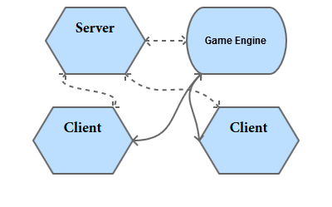
Network Architecture

Slide 4
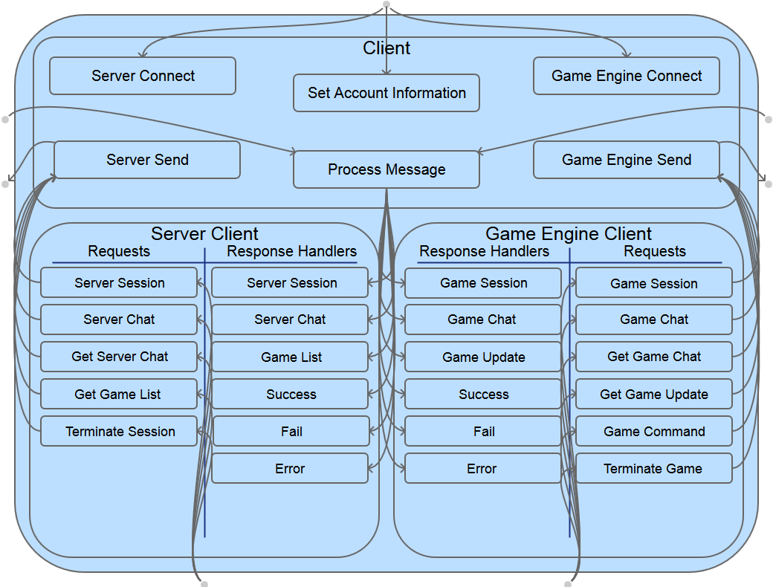
Client Logic

Slide 5
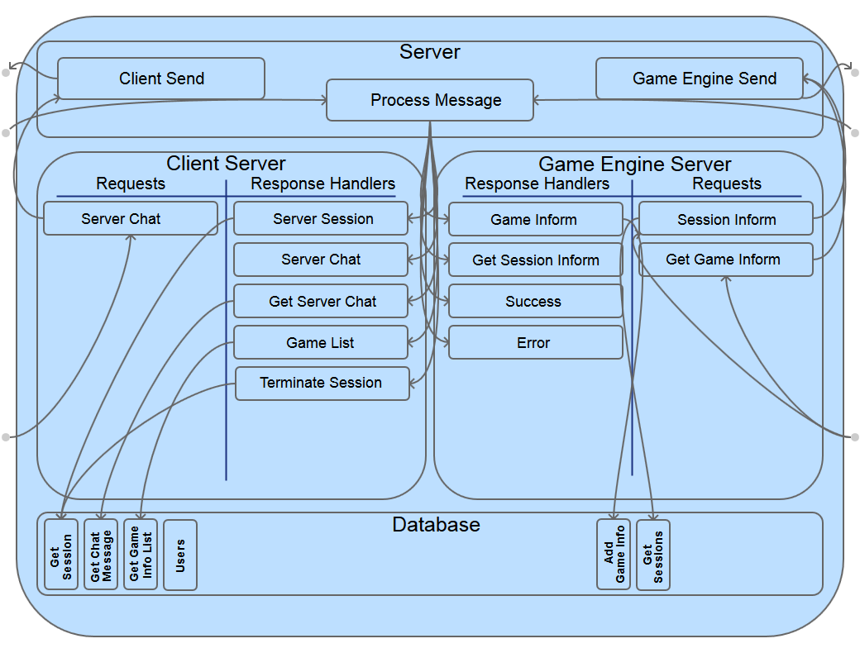
Server Logic

Slide 6
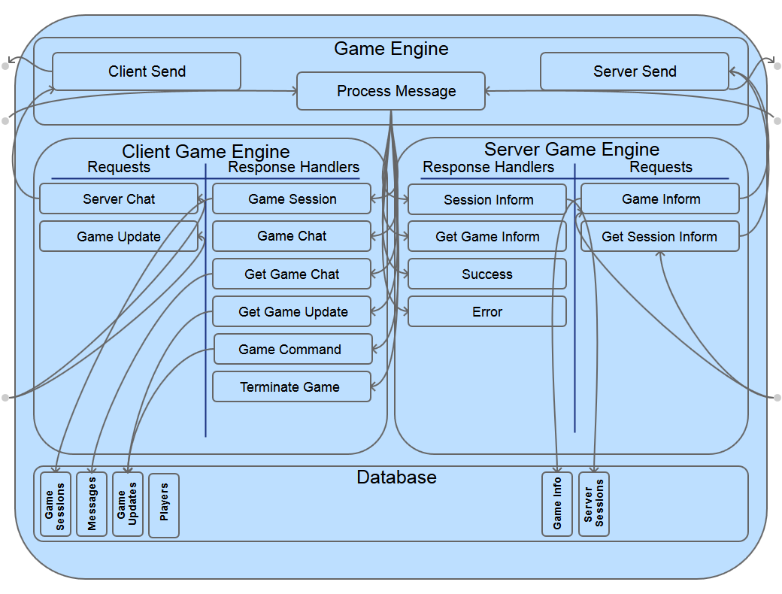
Game Engine Logic

Slide 7
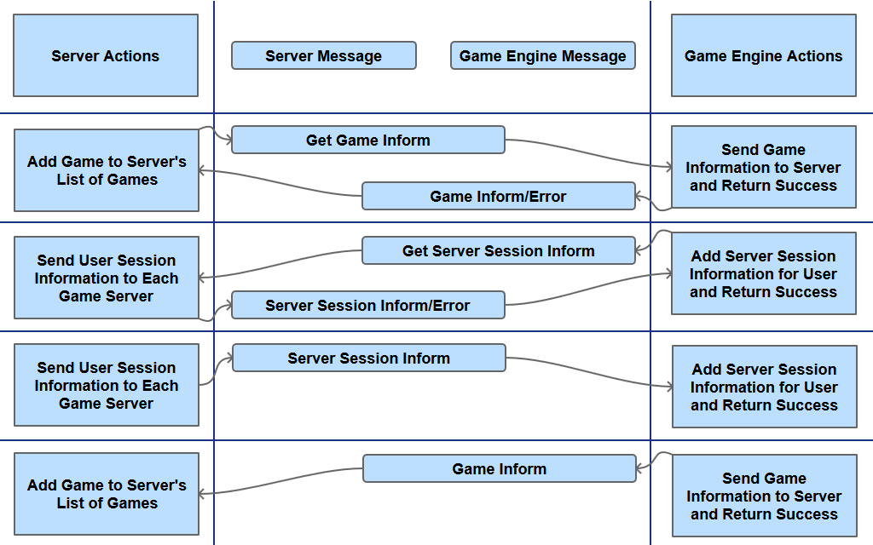
Server - Game Engine Dialogue

Slide 8
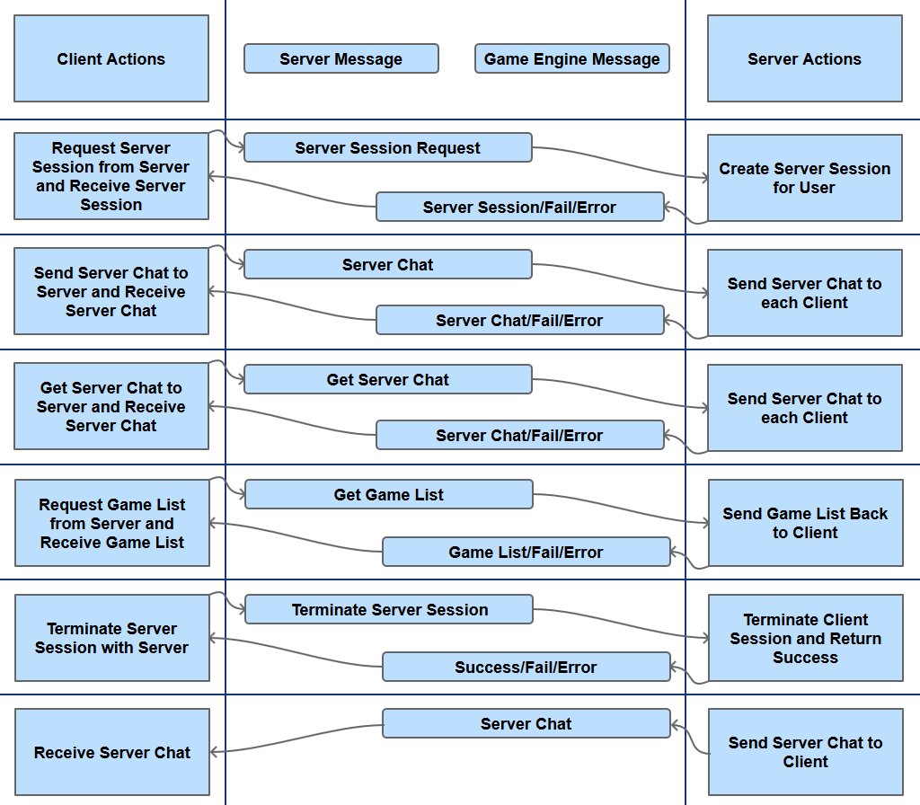
Client - Server Dialogue

Slide 9
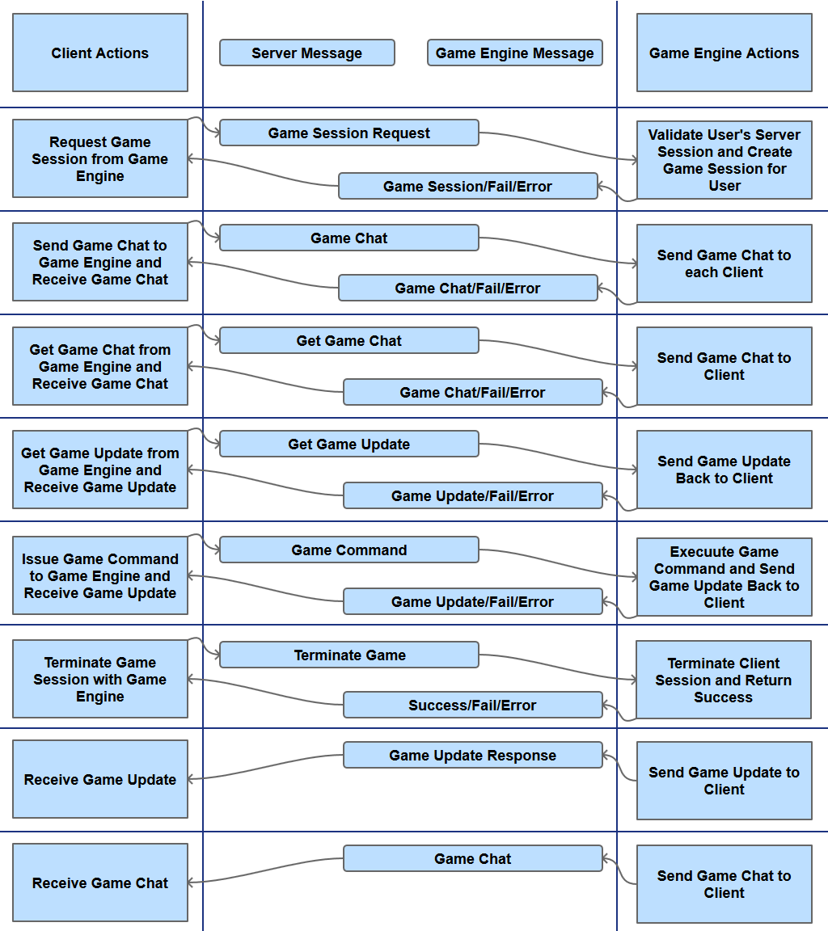
Client - Game Engine Dialogue

Slide 10
Responsive UI
Desktop Native
Desktop Web
Desktop Mobile

Slide 11
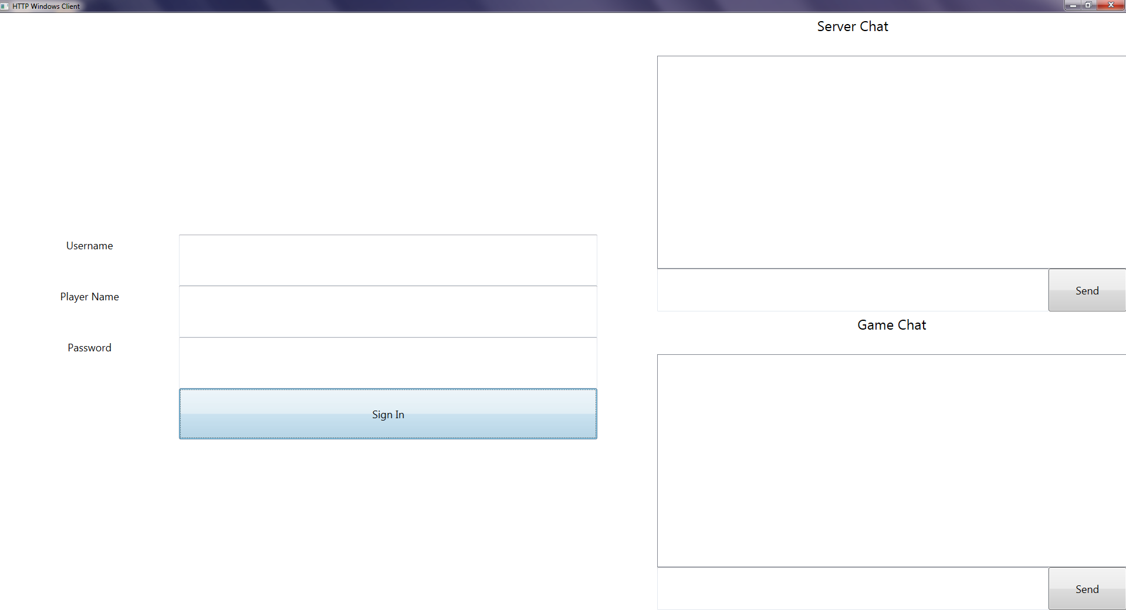
Desktop Native (Large)

Slide 12
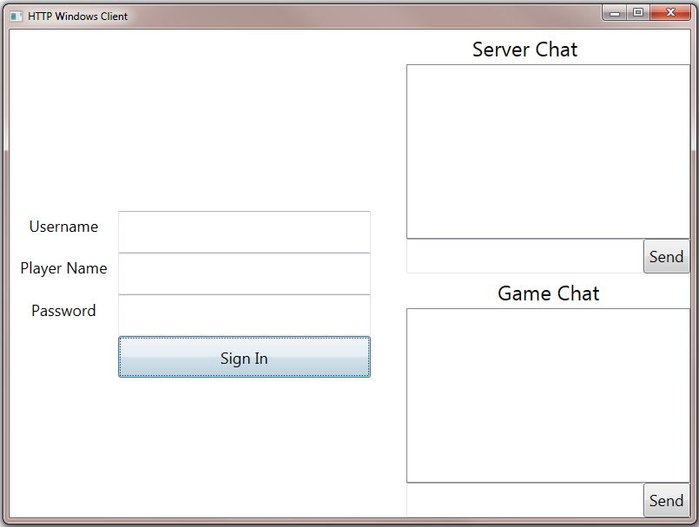
Desktop Native (Small)

Slide 13
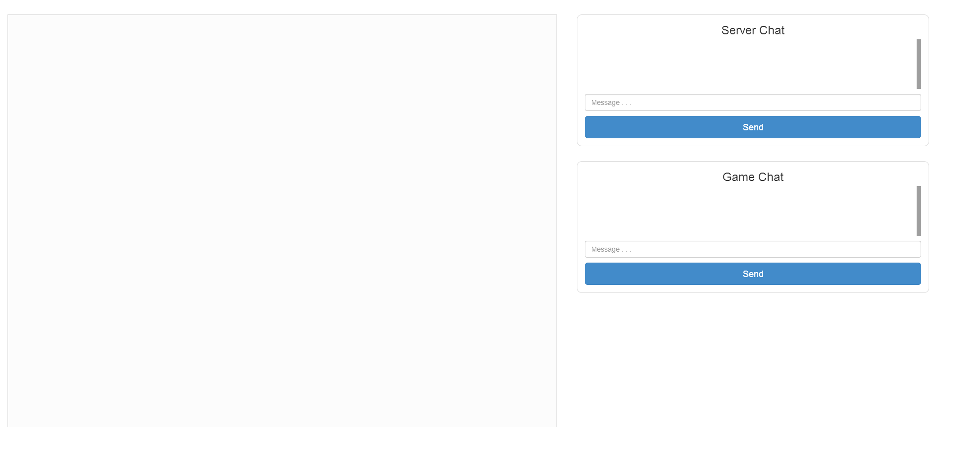
Desktop Web (Chrome)

Slide 14
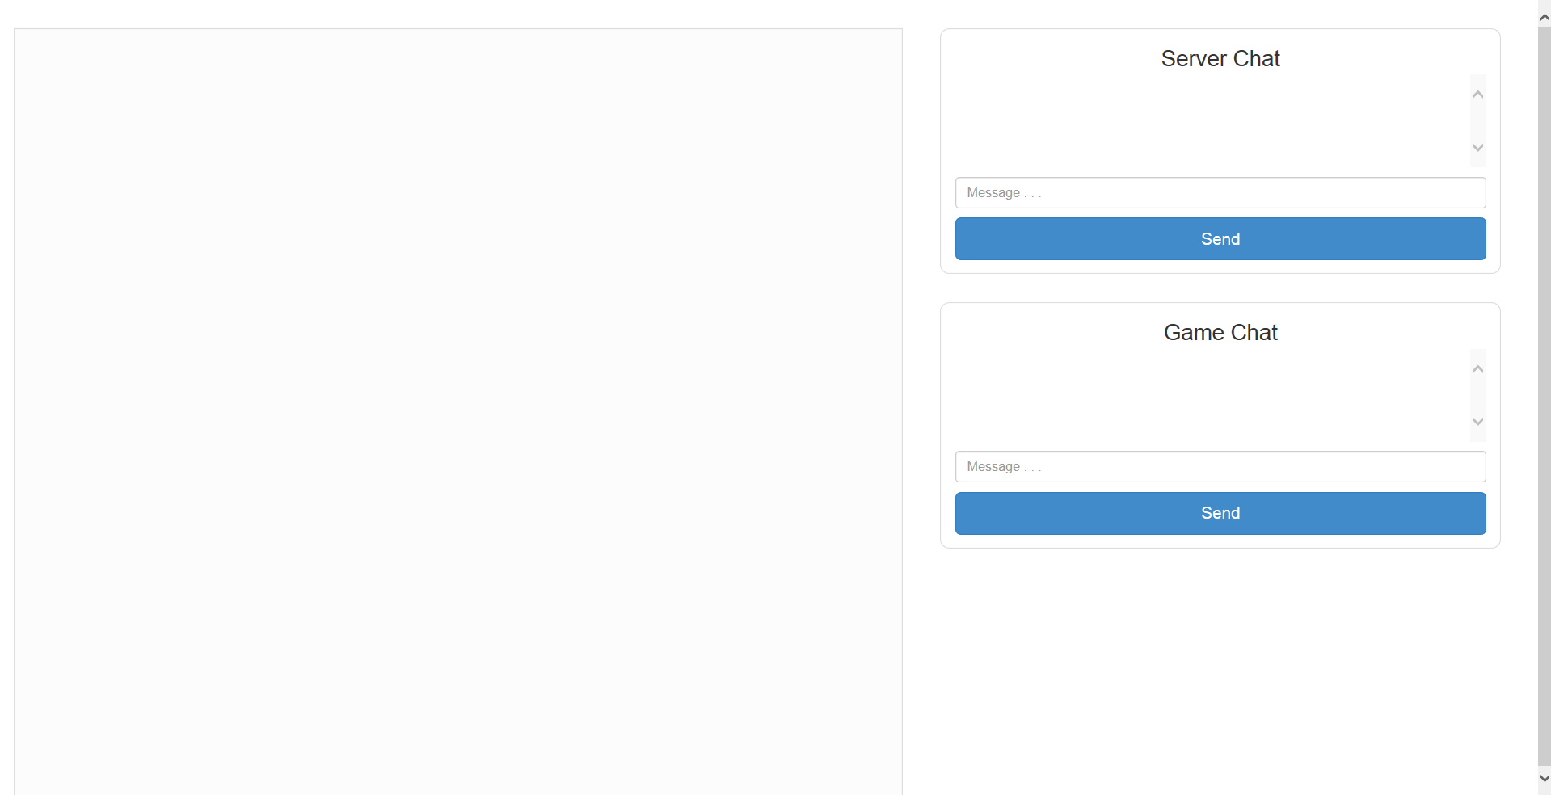
Desktop Web (Internet Explorer)

Slide 15
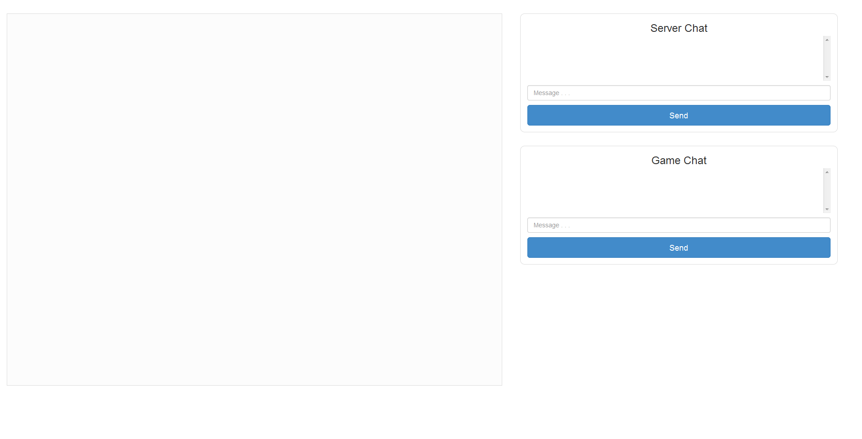
Desktop Web (FireFox)

Slide 16
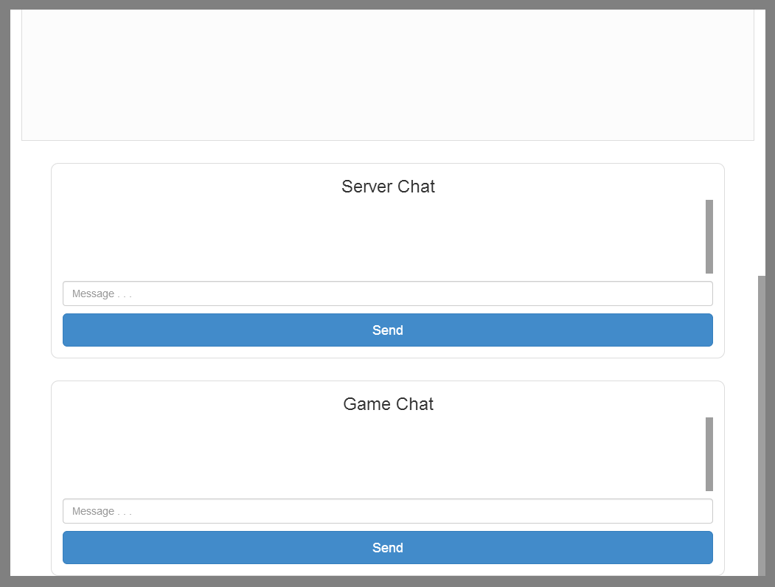
Mobile Web (ipad)

Slide 17
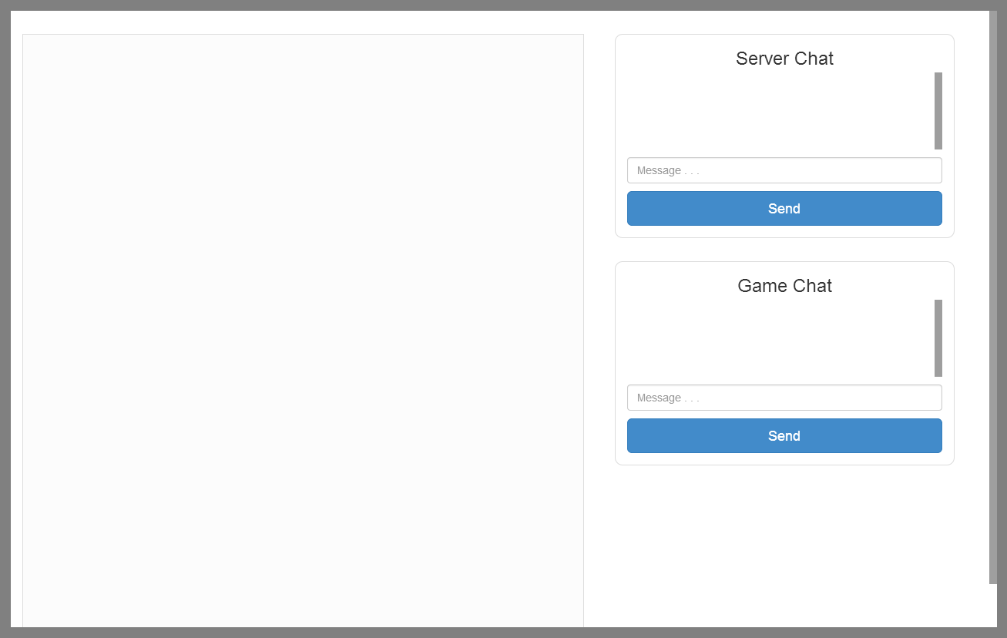
Mobile Web (Nexus 10)

Slide 18
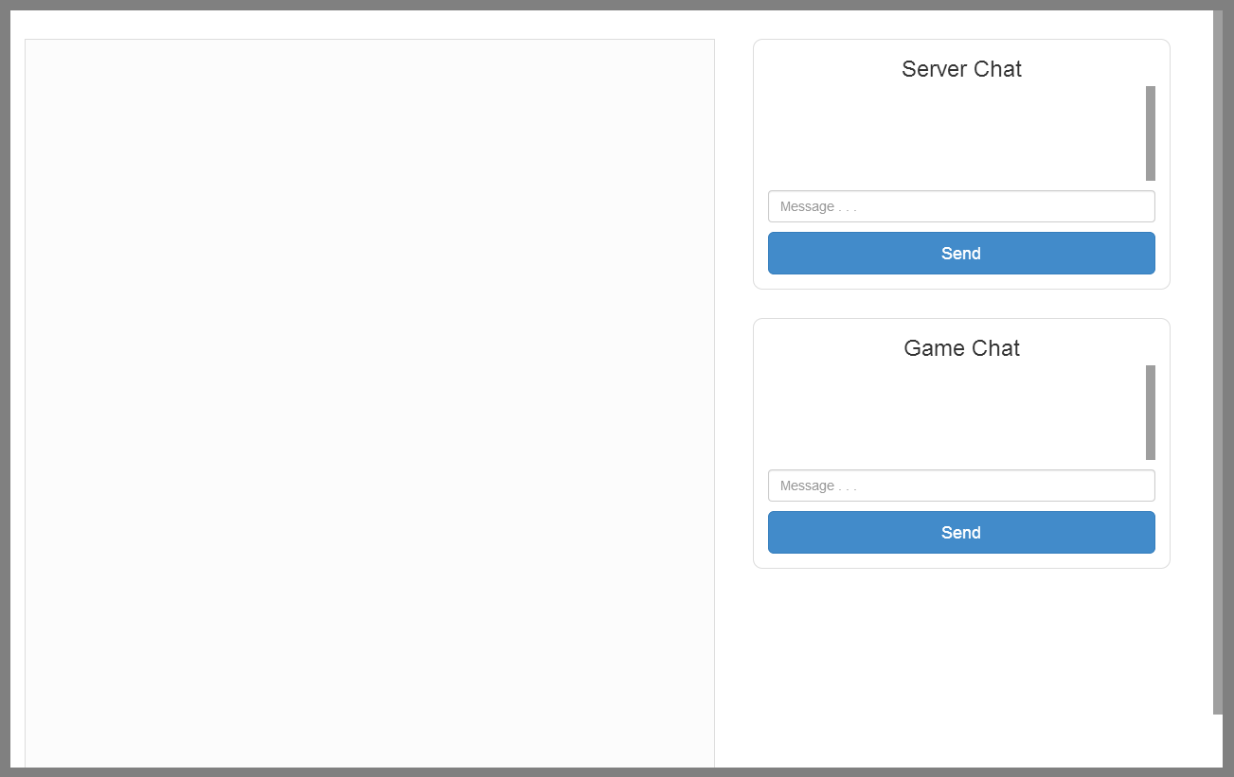
Mobile Web (Kindle Fire HD)

Slide 19
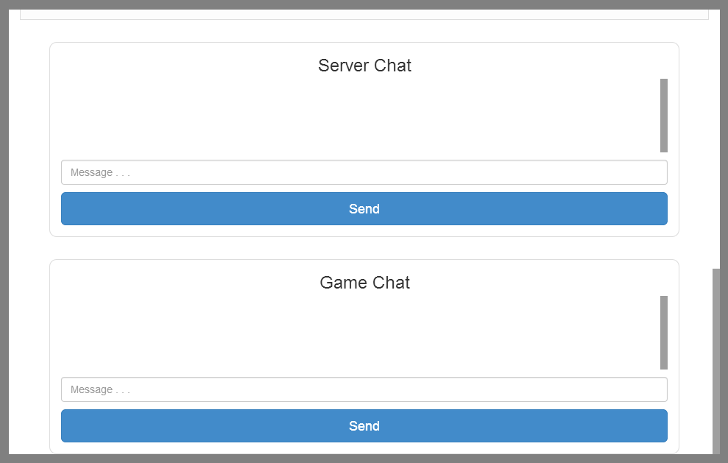
Mobile Web (Nexus 7)

Slide 20
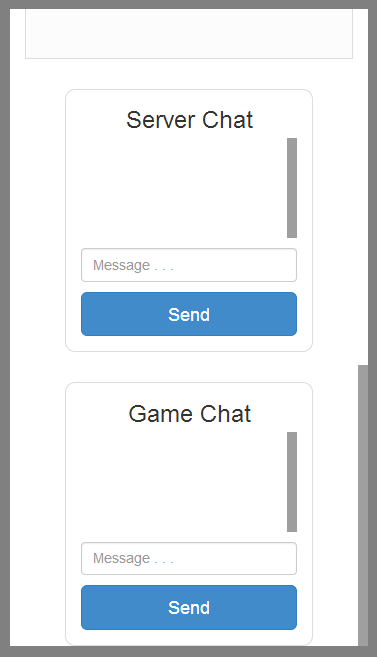
Mobile Web (Nexus 5)

Slide 21
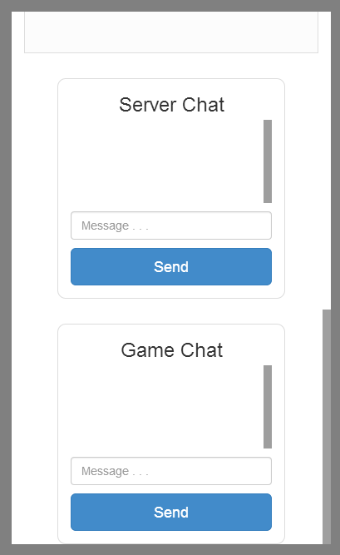
Mobile Web (BlackBerry)

Slide 22
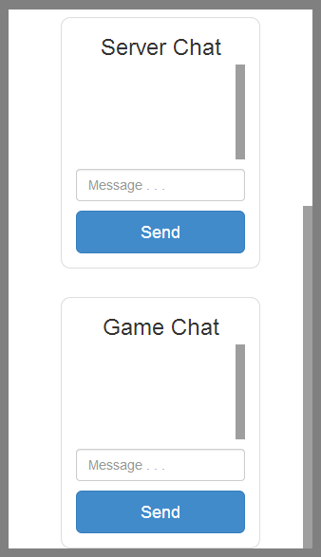
Mobile Web (iPhone)

